Slide 1
Tweet data loading and preprocessing
(Kaggle)

Slide 2
Outline
Data loading
Data preprocessing

Slide 3
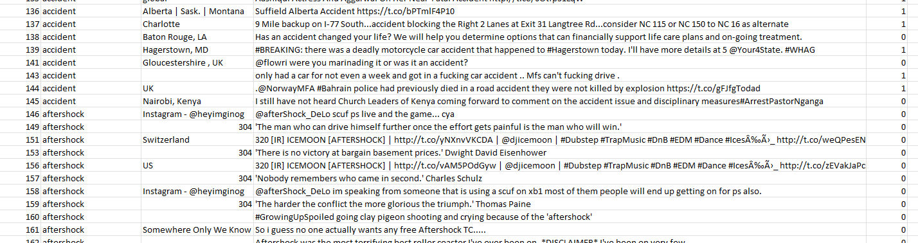
Data loading
The training data is stored in a Comma Separated Values (CSV) file.
Each sample has 5 attributes.
ID
Keyword
Location
Tweet content
Label

Slide 4


Data loading (2)
Use pandas to read the csv file as a data frame
https://pandas.pydata.org/docs/
Important.

Slide 5
Data preprocessing
Noches El-Bestia '@Alexis_Sanchez: happy to see my teammates and training hard ?? goodnight gunners.?????? http://t.co/uc4j4jHvGR'
url
Special characters
((OFFICIAL VID)) #DoubleCups &gt;&gt; https://t.co/lfKMTZaEkk &gt;&gt; @TrubGME Prod @THISIZBWRIGHT &gt;&gt; #ARMAGEDDON
Capitals
Username
Uniform resource locators (urls) and special characters needs to be cleaned.
“@username”s should be cleaned because no actual information provided by them.
The capital letters needs to be transformed to lower cases.

Slide 6
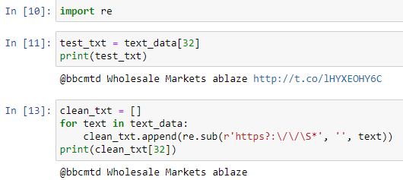

Data preprocessing (2)
Use regular expression (re) to clean the text data.
Regular expression cheat sheet:
https://www.rexegg.com/regex-quickstart.html
Remove URL
r’https?:\/\/\S*’
‘r’:
The solution is to use Python’s raw string notation for regular expression patterns; backslashes are not handled in any special way in a string literal prefixed with ‘r’
‘https?’:
s? means match s zero or one time. Thus, https? Matches http or https.
‘\/\/’:
‘\/’ matches one ‘/’. ‘\/\/’ matches ‘//’
‘\S*’:
‘\S’ matches a character that is not a whitespace. ‘*’ means matches the previous expression zero or multiple times. ‘\S*’ can match a string with no whitespace of any length. (e.g.: lHYXEOHY6C)
Remove @username
‘\@\S+’
‘\@’: matches ‘@’
‘\S+’:
‘\S’ matches a character that is not a whitespace. ‘+’ means matches the previous expression one or multiple times.

Slide 7
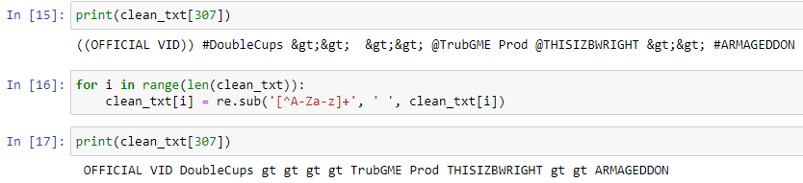
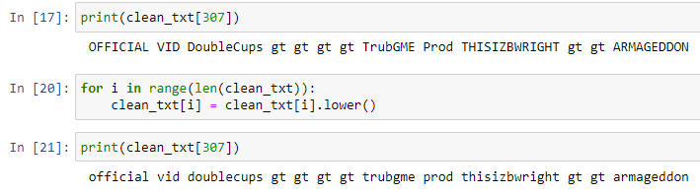
Data preprocessing (3)
Remove special characters. (Remove the numbers as well, because they don’t provide vital information for disasters.)
[^A-Za-z]+
‘[]’:
Matches all elements in the set.
‘^’:
When ‘^’ is in ‘[]’, it means not.
‘A-Za-z’:
All characters from A-Z and a-z.
‘+’:
Matches one or multiple times.
‘[^A-Za-z]+’ matches any special characters.
str.lower() is a python built-in method that transforms all capitals to lower case letters.

Slide 8

Problems
Meaningless words before and after cleaning.
Meaningless word after cleaning.

Slide 9

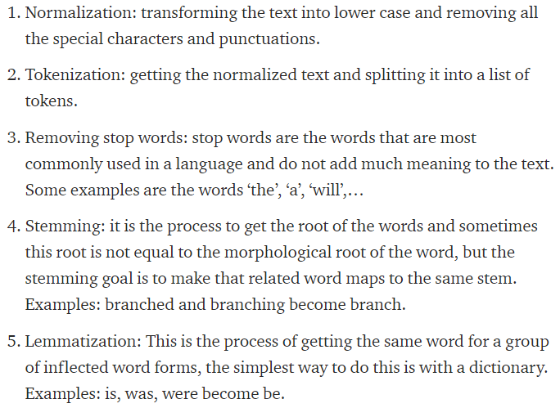
Next step
6. Vectorize the text
https://medium.com/analytics-vidhya/best-nlp-algorithms-to-get-document-similarity-a5559244b23b

